Slide 1
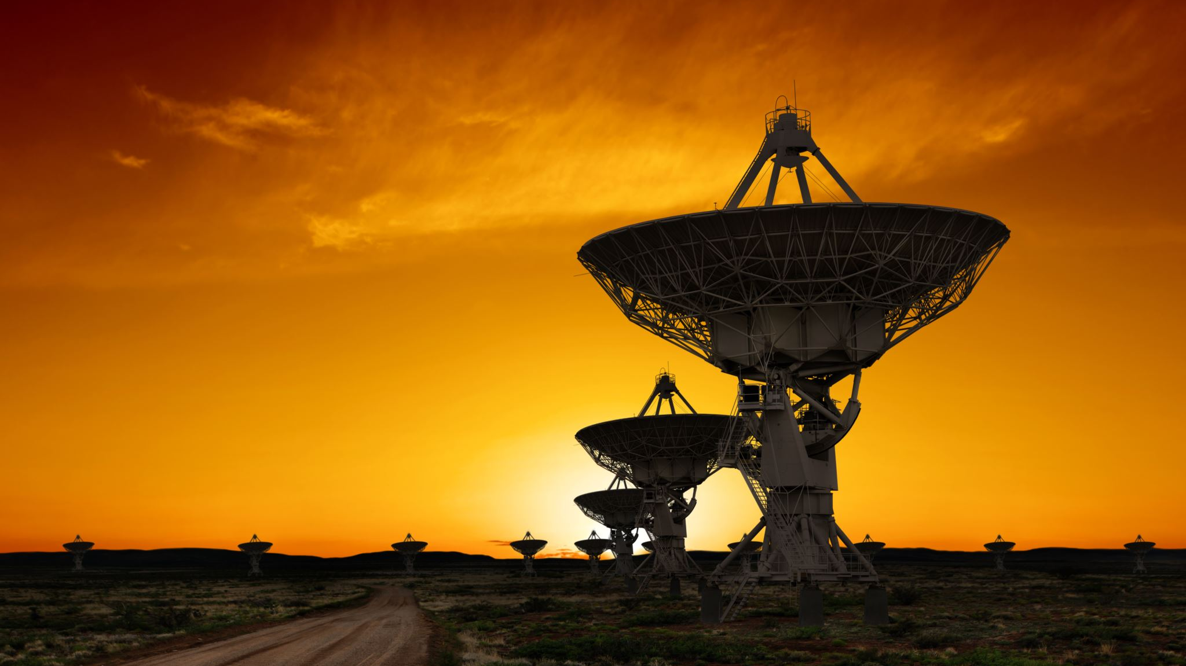
Mars Rover – Group 3
Aurora Clark , Malina Brown , Ethan Zumbahlen

Slide 2
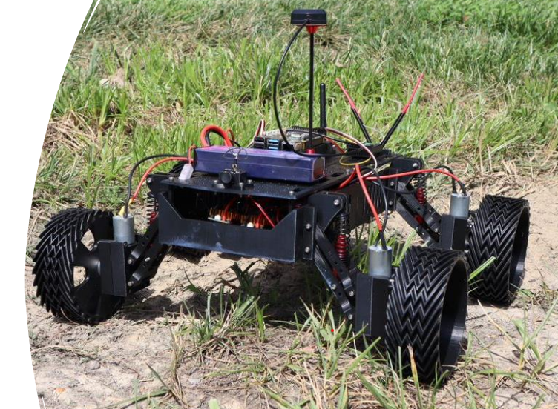
Introduction
Group Project includes three sections:
Hardware Build
Avionics Configuration
Data gathering/Autonomous driving

Slide 3
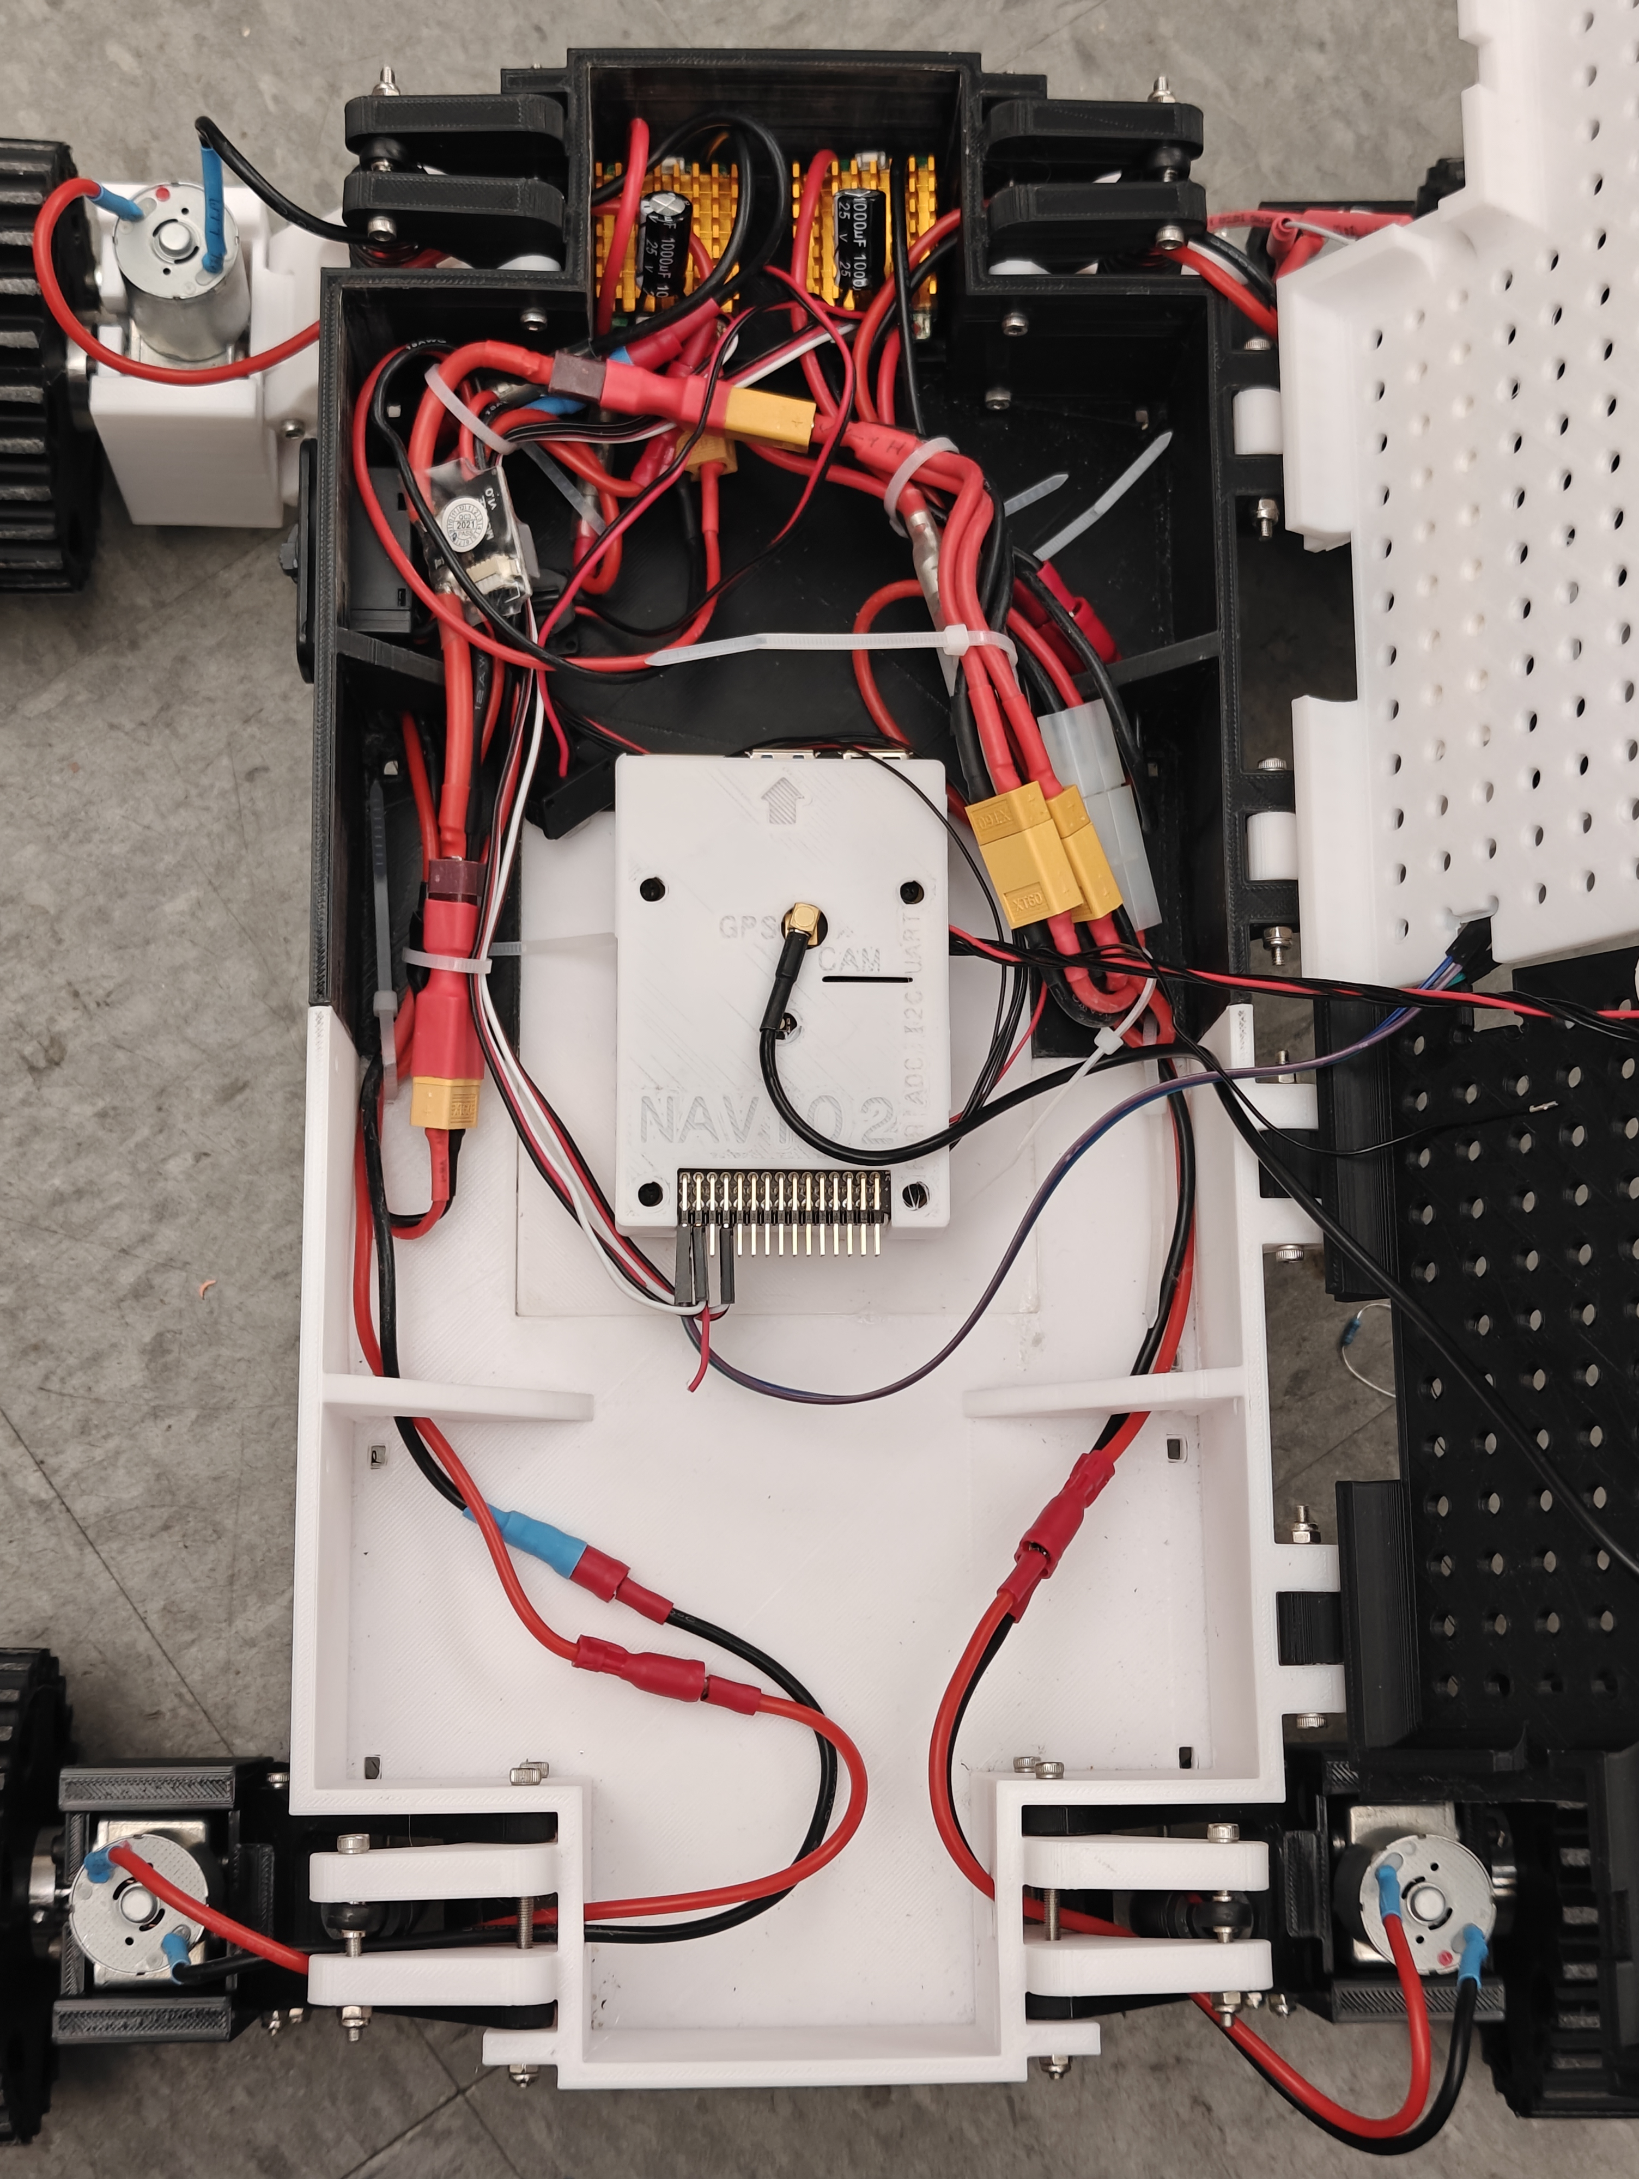
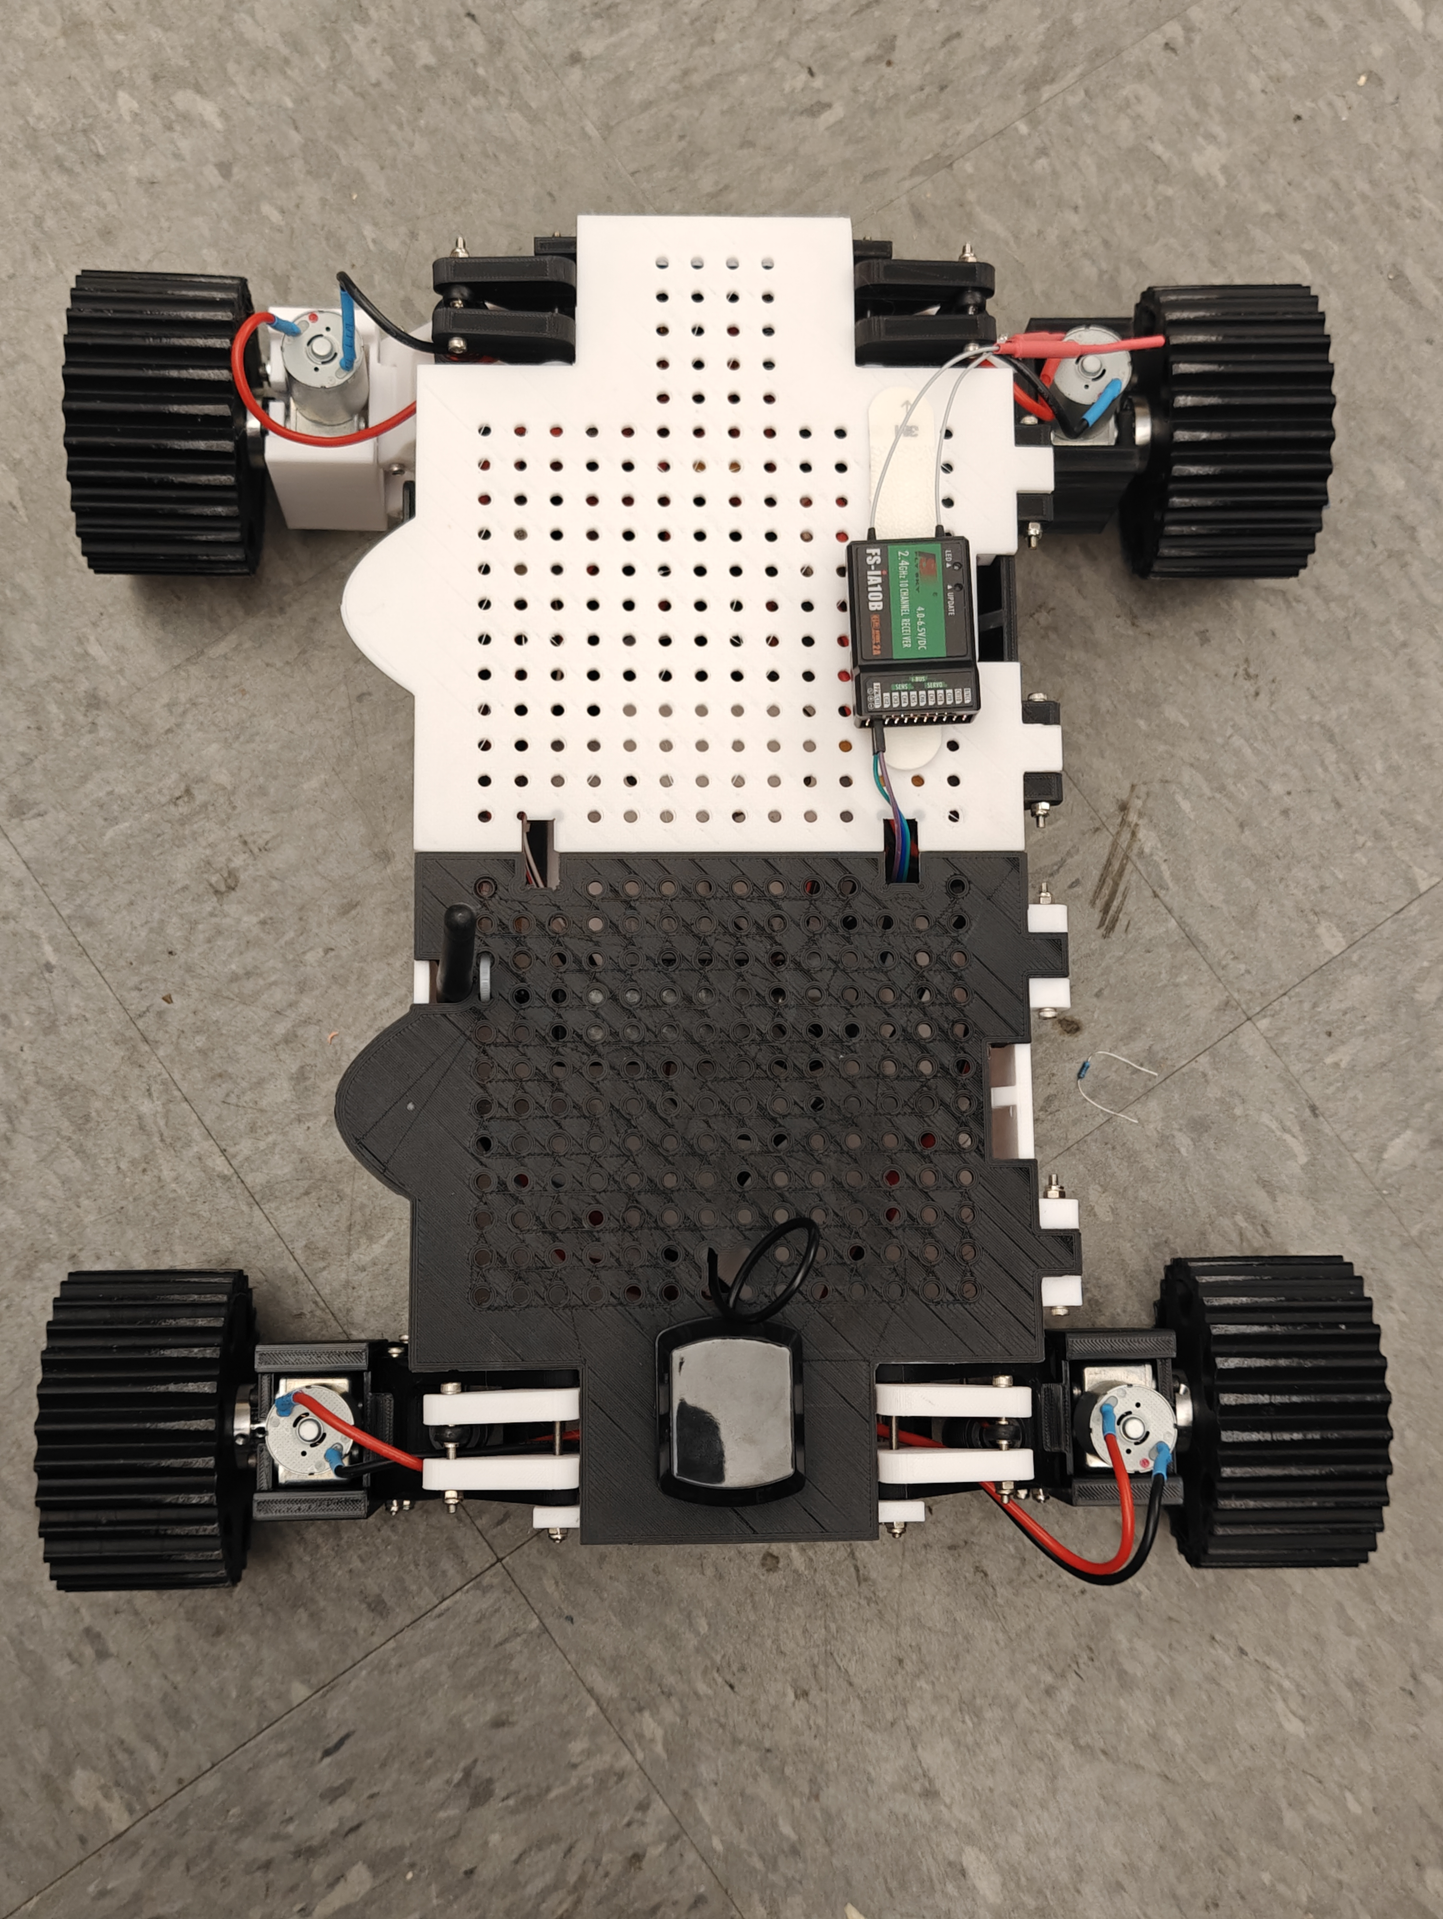
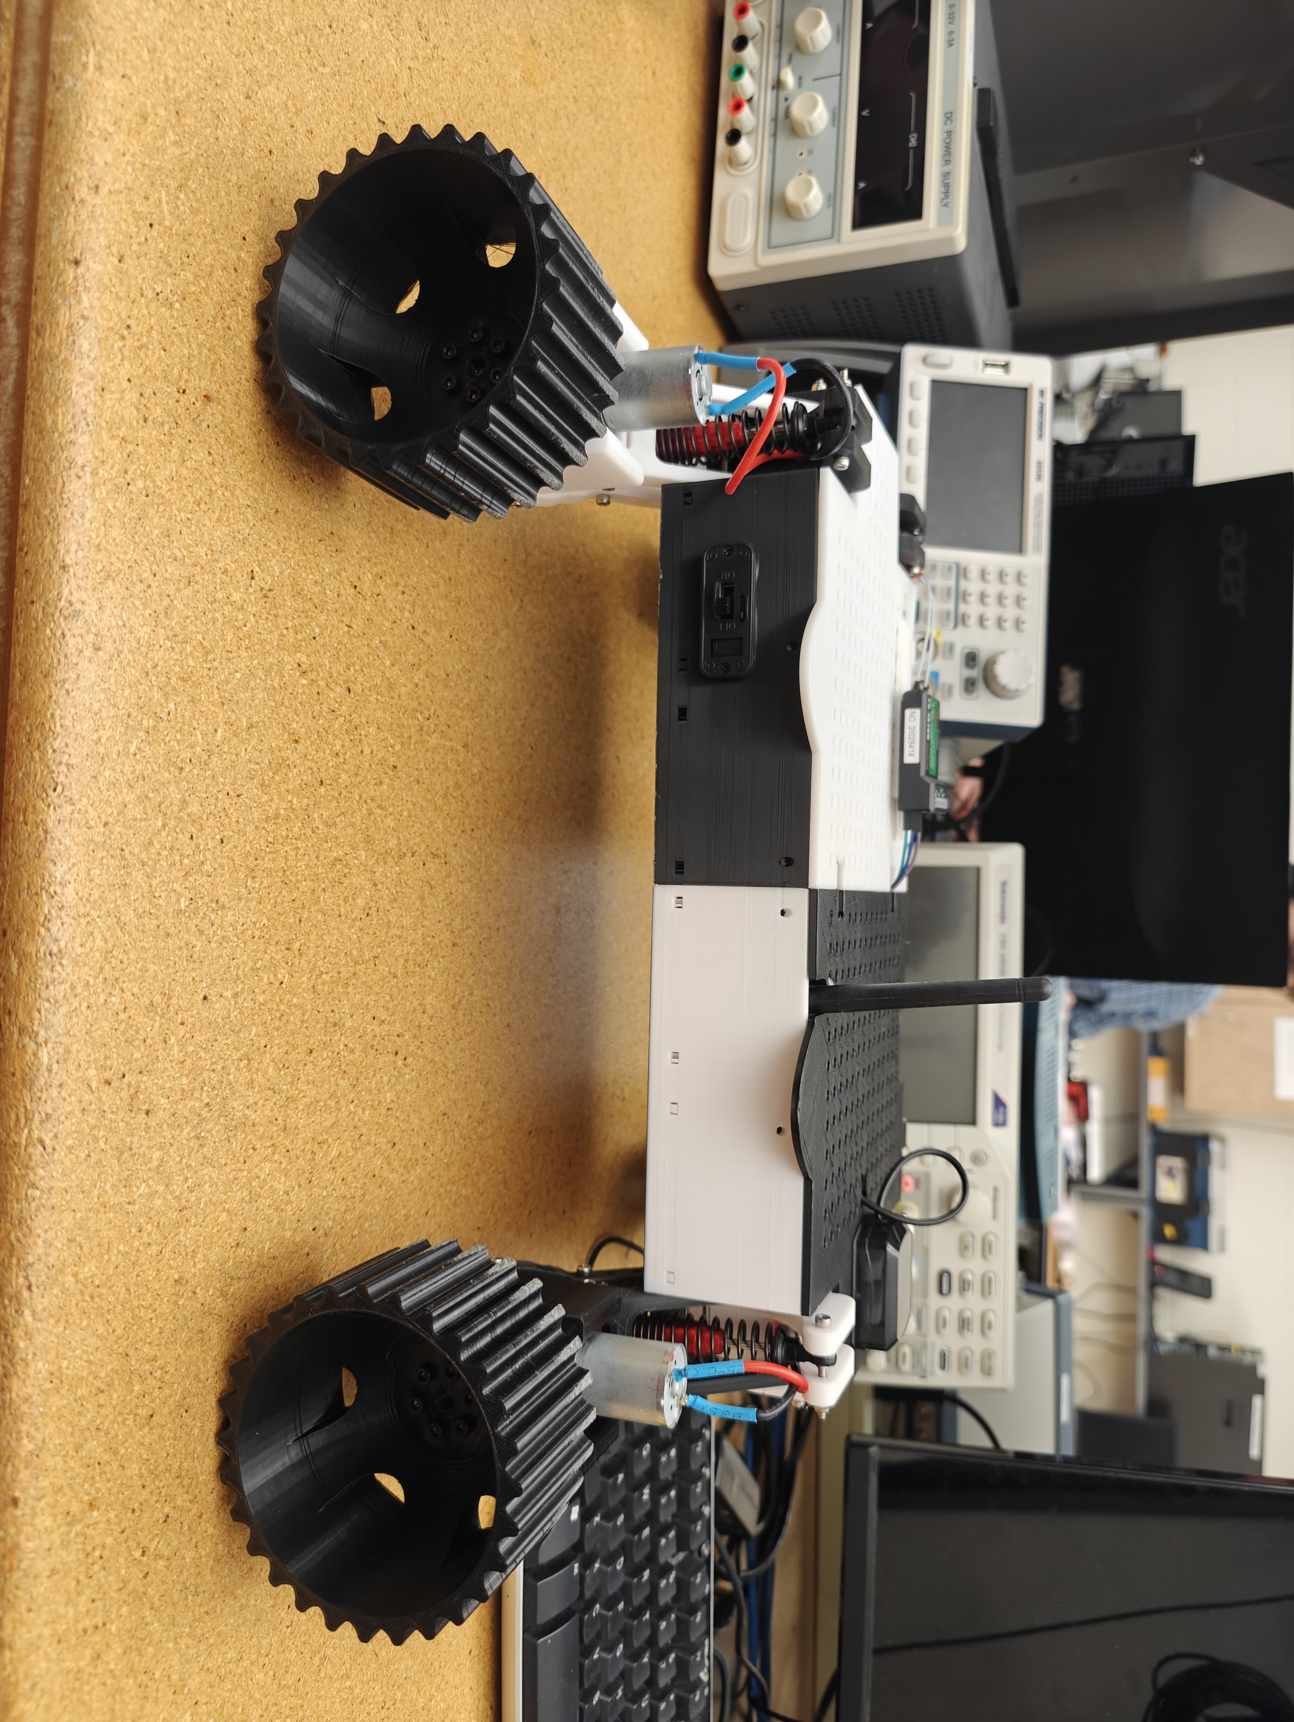
Hardware Build:

Slide 4
Assembling the Case:
Assembling the case had 3 different steps
The main case
Consists of the main box and lid
The suspension
Shock absorbers, suspension arms
And the motors
Motors, motor mounting boxes, wheel hubs, and wheels
Notes:
Main case – the first part of assembly was simple, as it only consisted assembling the box and lid tied together with long screws that act as hinges
because the set was a pre-used kit, we didn't have to glue them together
The suspension – the suspension consisted of the upper and lower wishbones, which holds the shock absorbers in place which help the the internal components stay steady and not bump around
The motors – the motor assembly is what allows the rover to move, each arm has a motor and each motor has a wheel. The wheel hub is what allows the wheel to be mounted to each motor

Slide 5
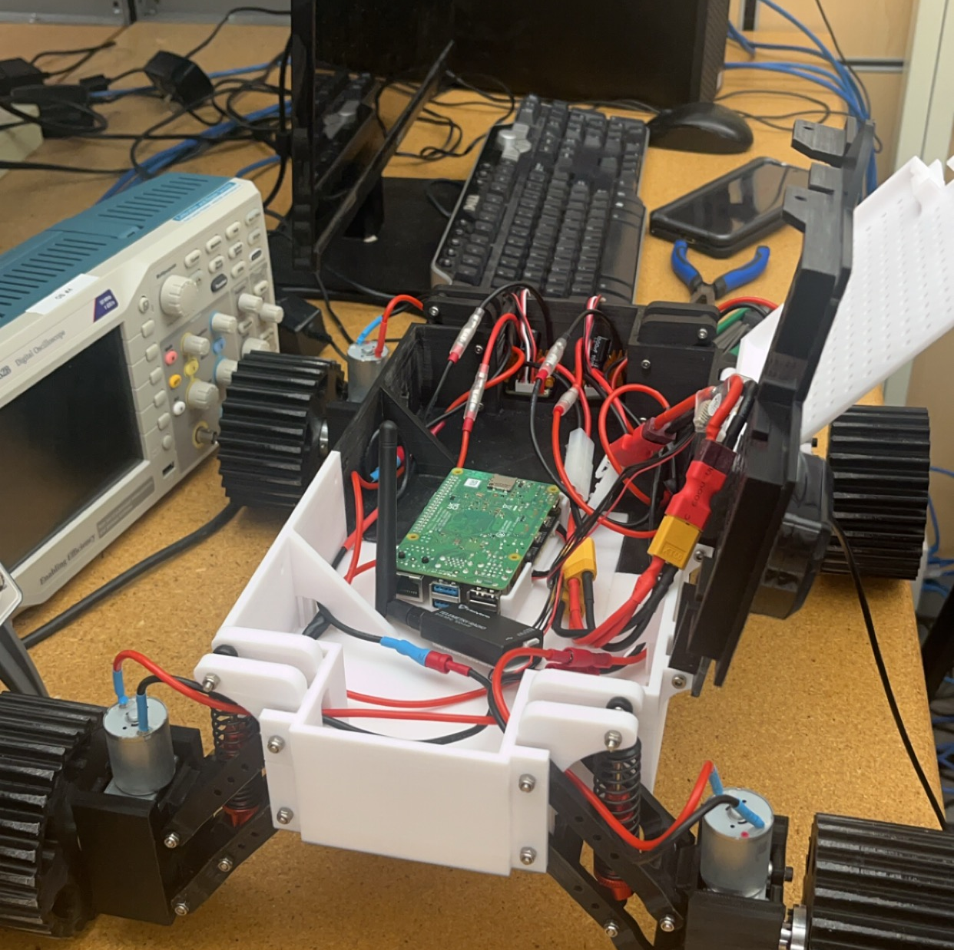
Electronic Component Assembly:
Navio and its connections
GPS antenna, telemetry radio, Remote Control Receiver
Motor drivers
Cable splitter, XT60 adapter
Power module
Power switch
Notes:
Motors had to be connected to the wire harnesses to connect to the motor drivers which then connected directly to the navio.
Power switch was connected to the power module which allowed the battery to be plugged into the rover.
The navio had the telemetry radio, GPS antenna, and the Remote Control receiver connected to it, and were the simplest to install because they were plugged into the navio directly.
For power the connections went as so: Motors > motor driver > XT60 adapter > Cable splitter > power module > power switch

Slide 6
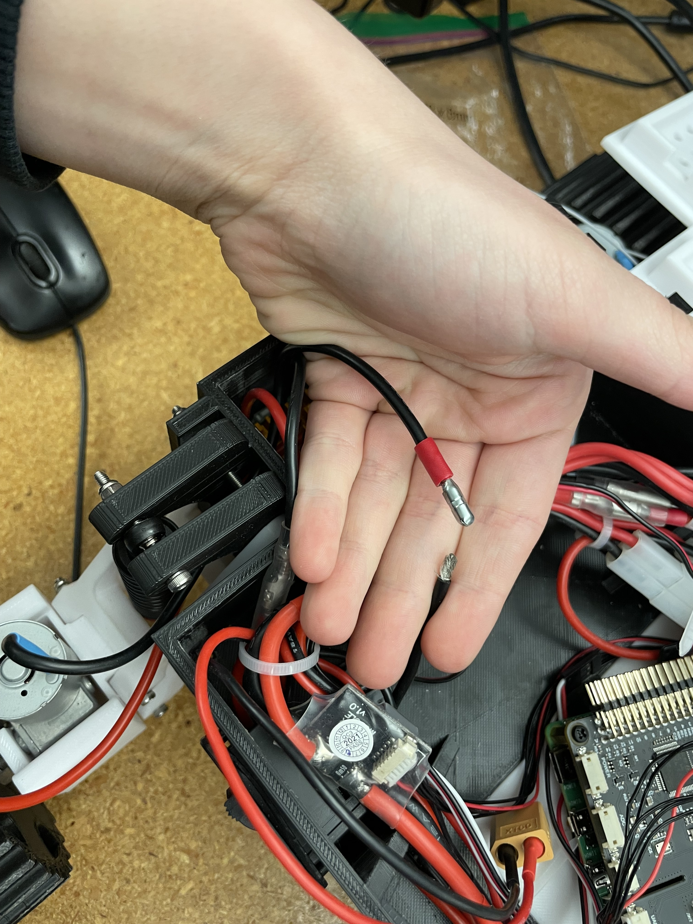
Troubleshooting:
What went wrong?
Female Bullet connector one of the wires needed to be re-clamped
Screws Around Motor were rubbing against wheel , not allowing wheels to rotate
Wheel hub keys started to strip, resulting in under tightened bolts causing entire wheel to fall off occasionally.
Notes:
The broken female clamp connected the rear right motor and the wire harness going to the right motor driver.
The screws that mounted the motor to the motor box had large heads. This caused the bolts that mounted the wheel to the hub rub against them and would lock up the wheels.
Solutions we found for this was to either move the wheel hub farther out on the axle, or to loosen the wheel from the base.
Small allen key which locked the wheel hub on the axle of the motor didn't seem to want to turn, weather the allen key is worn or the allen wrench was too small it couldn't be tightened as desired.

Slide 7
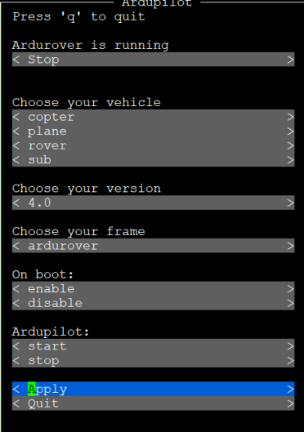
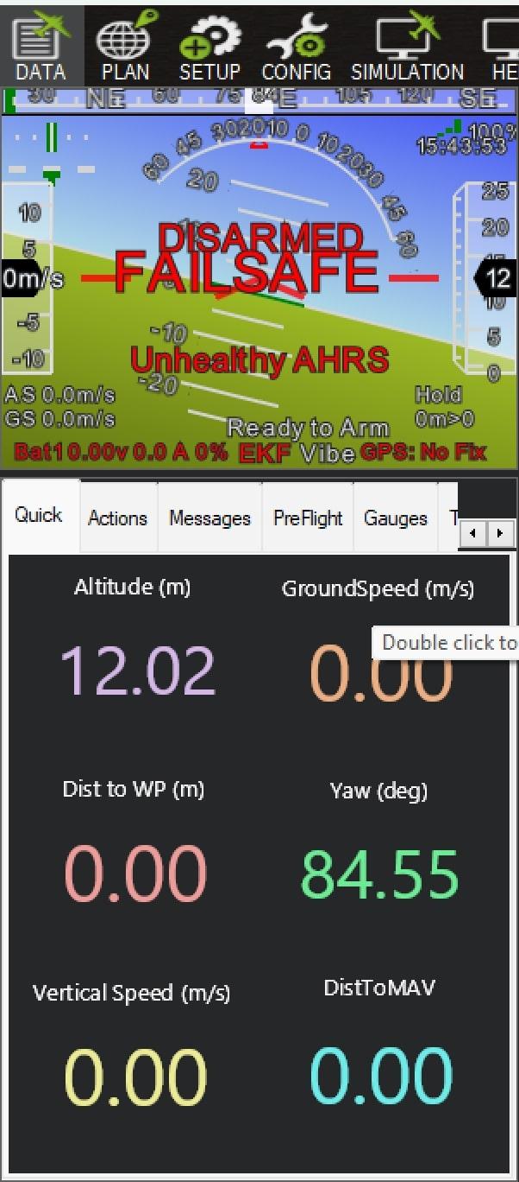
Avionics Configuration
1 – Download Etcher
Used to put Raspbian onto SD card
2 – Configure the software configurations
Done by connecting a keyboard and mouse to the Navio 2
3 – Telemetry configurations
Configures flight controllers to operate with our radios
4 – Mission Planner Configuration
Control Station that relays information to user

Slide 8
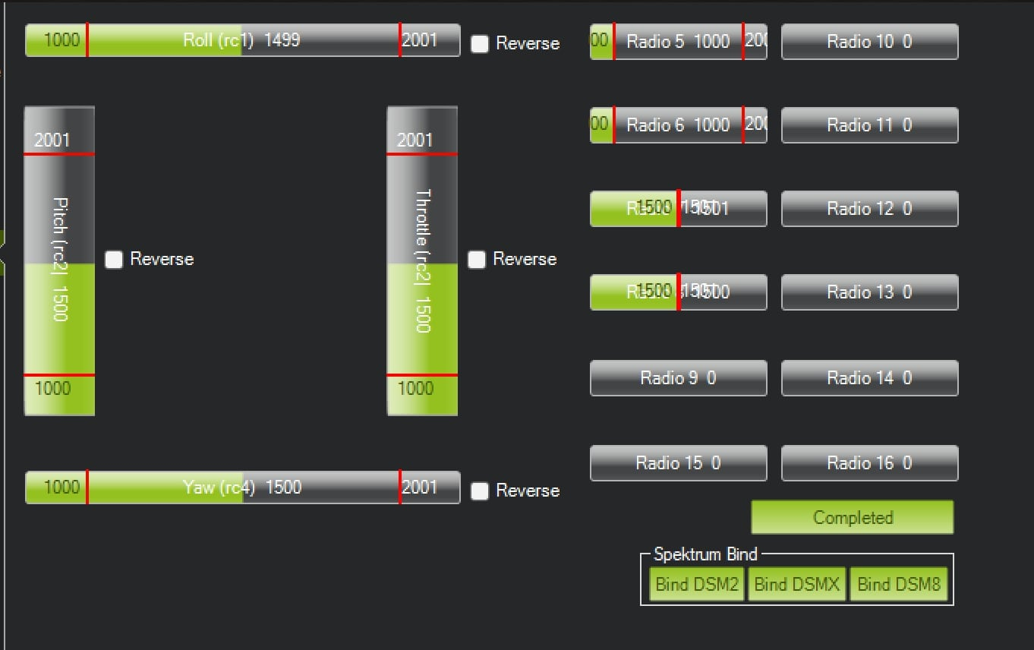
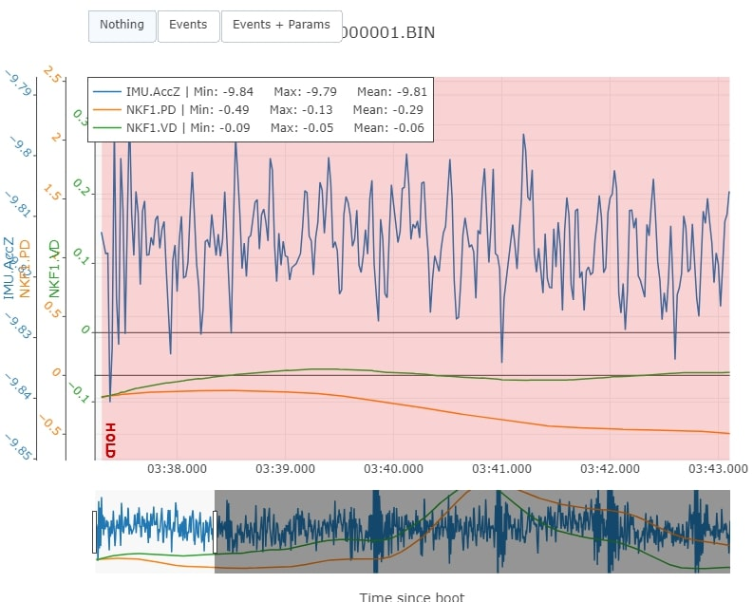
Avionics Configuration
5 – Setup Mission planner using Telemetry
Here we will connect radios by setting their Net IDs equal
6 – Adjusting parameters
These need to be adjusted so that we are correctly testing our data
7 – Calibration
Needs to be done in order for the accelerometer to identify information
8 – Creating waypoints
Represents the path vehicle will follow during autonomous testing
9 – Data Extraction ->

Slide 9
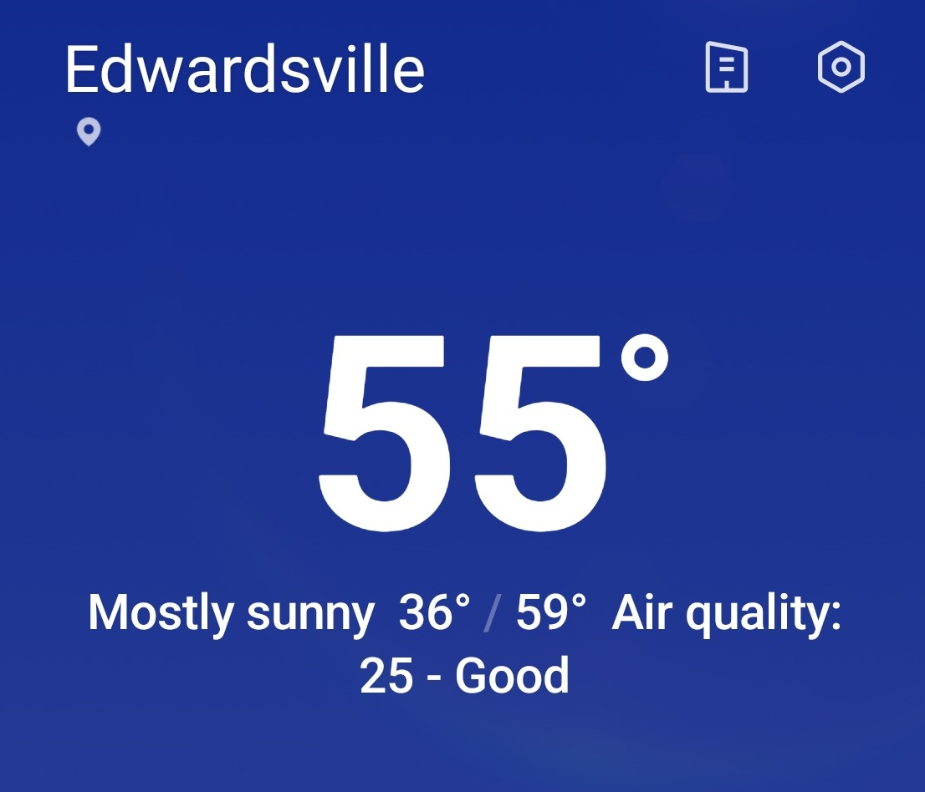
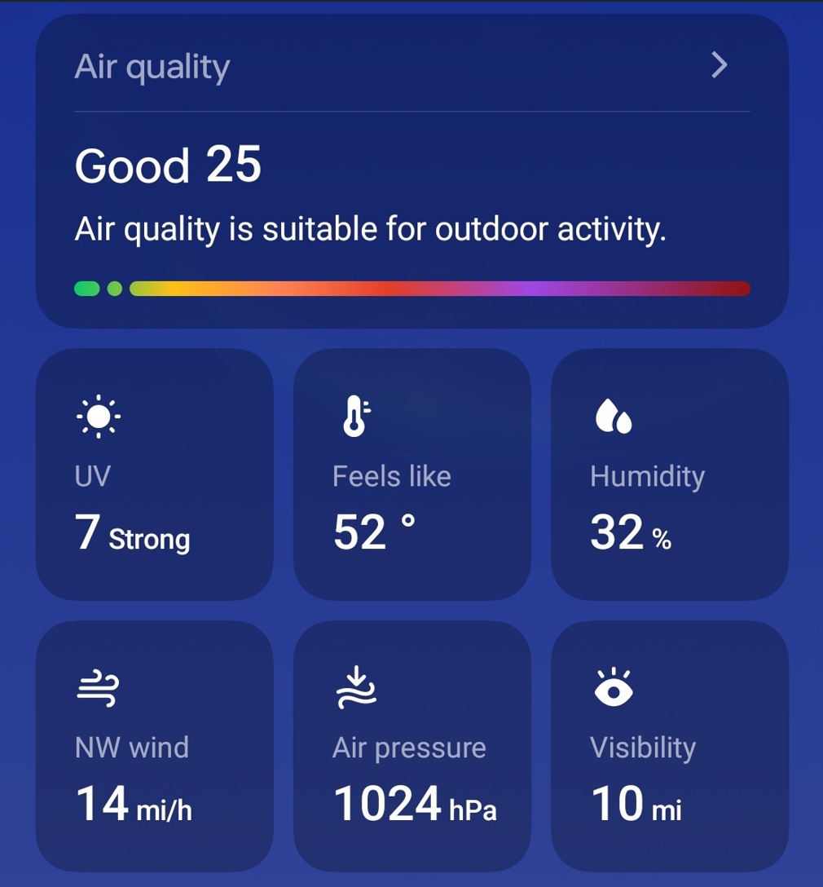
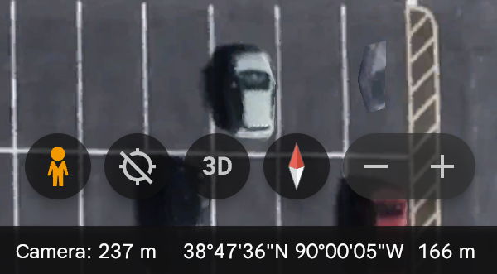
Weather Data Ground Truth:
The Weather Channel/ Google Earth
Temperature | 55°
Air Pressure | 1024 hPa
Altitude | 166m

Slide 10
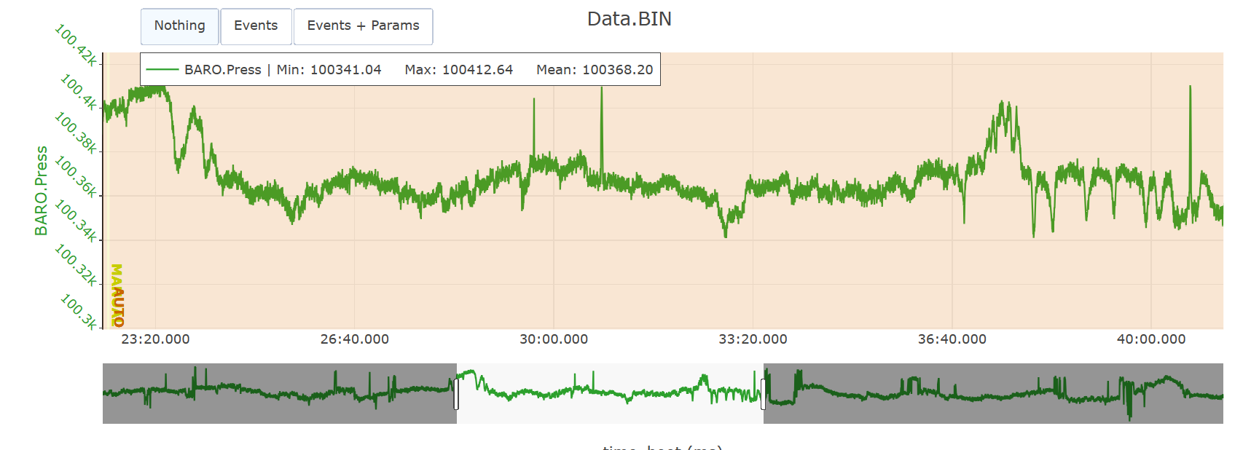
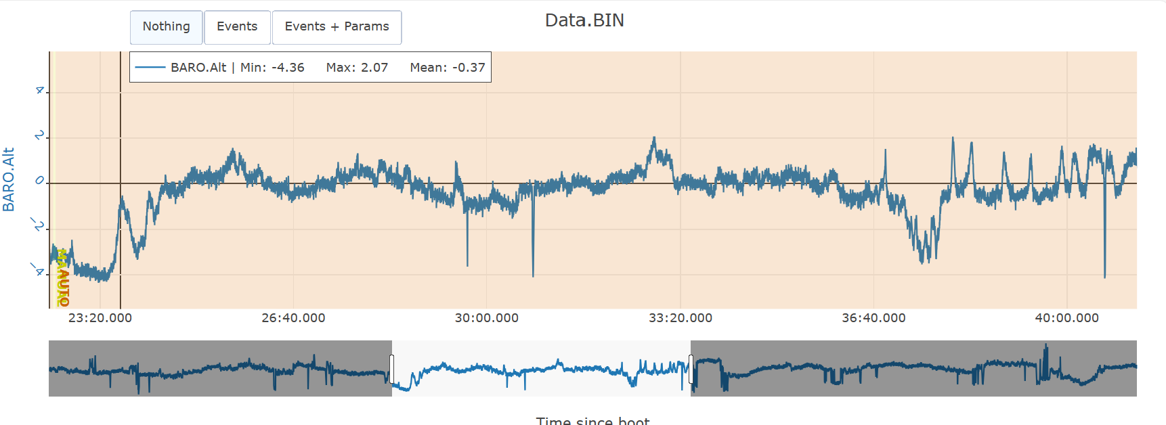
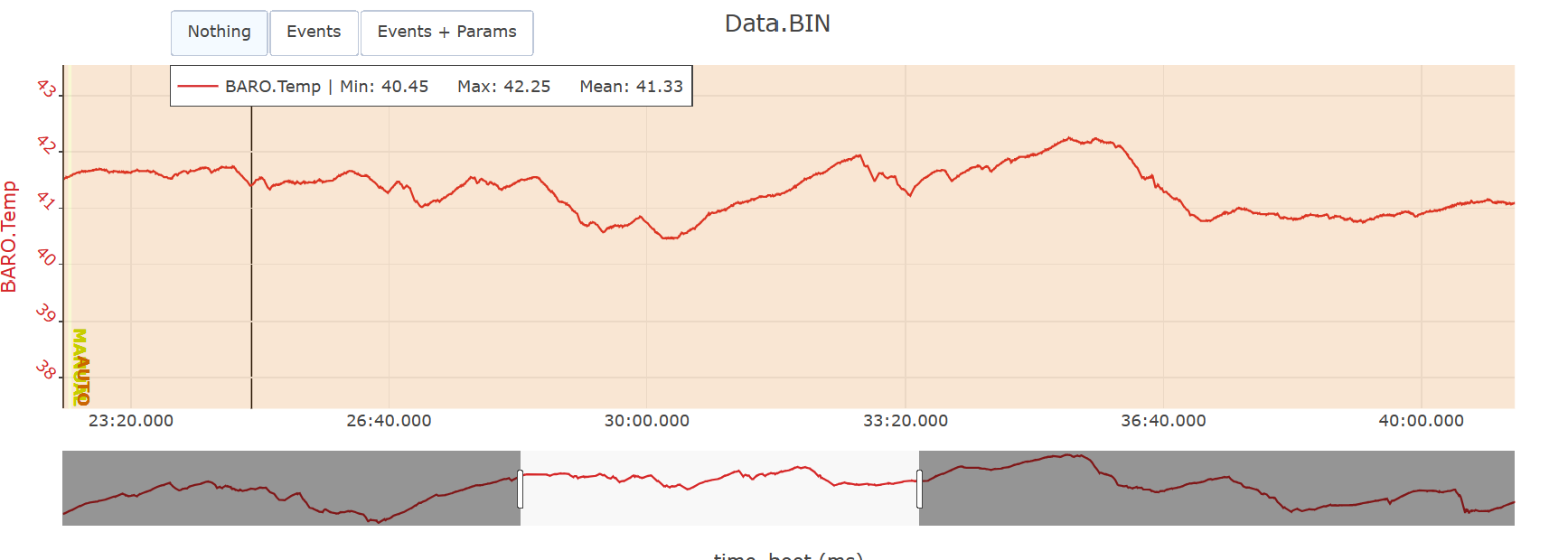
Onboard Barometer Data Graph:

Slide 11
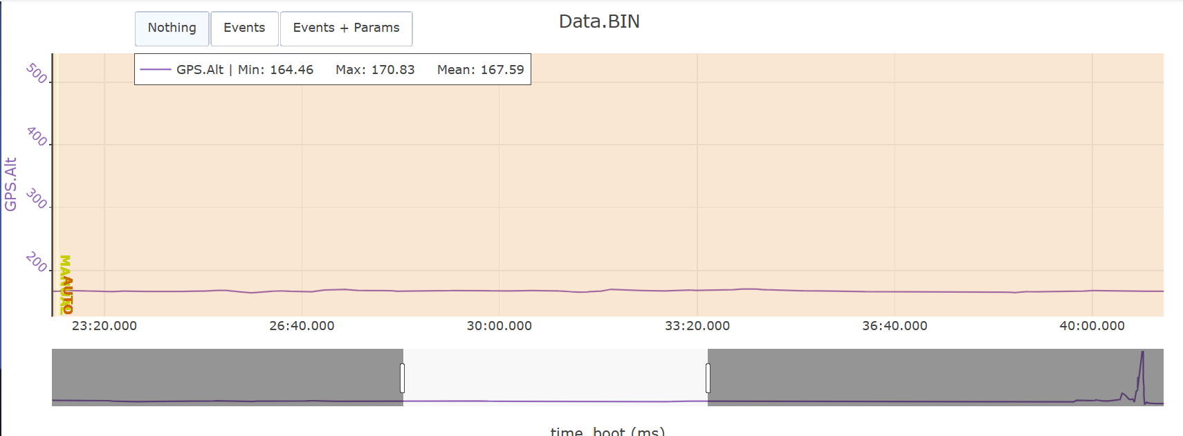
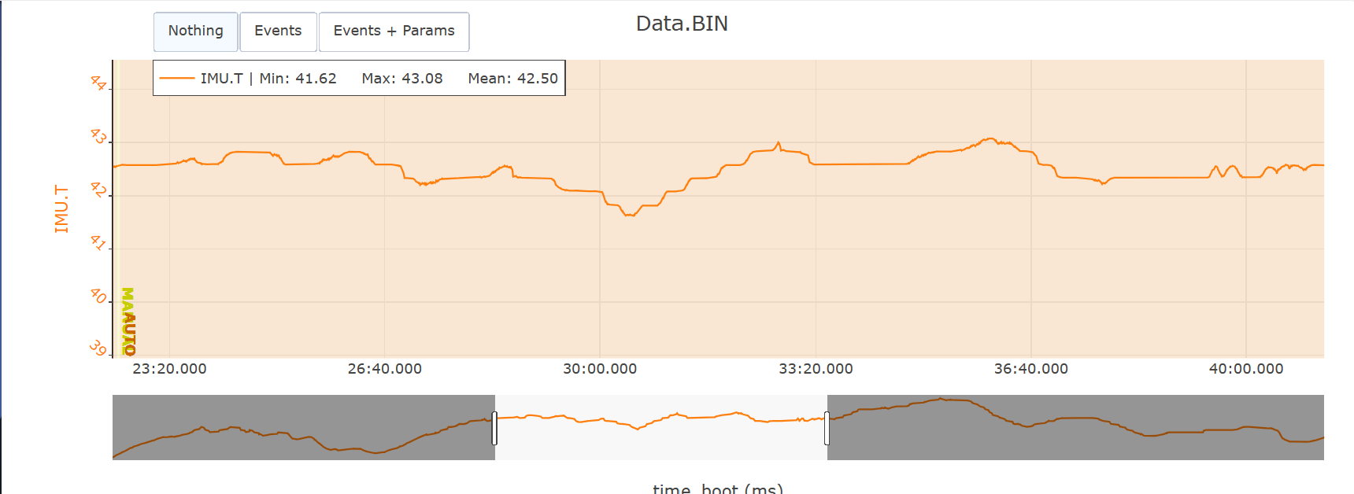
IMU and GPS Data Graph:

Slide 12
Task I – Weather Data Collected:
Temperature -
While researching how temperature compensation in the sensor works, we referred to multiple sources, two of them being: (https://www.faa.gov/air_traffic/publications/atpubs/aim_html/chap7_section_3.html) and (https://ardupilot.org/copter/docs/common-baro-temp-comp.html). This led us to believe that the temperature compensation is used to "calibrate" altitude when the temperature (BARO.Temp) increases the altitude believes its closer to sea level.
Altitude -
The GPS.Alt min = 164.46m, max = 170.83m, mean = 167.59m. The Ground Truth (Google Earth) = 166m. The GPS.Alt and ground truth are close in measurement.
Pressure -
The BARO.Press 100365 Pa = 1003.65 hPa. The Ground Truth (The Weather App) = 1024hPa. Even though the BARO.Press is used to calculate the BARO.Alt, it and the ground truth are close in measurement.
Sensor Improvement Plan when using DHT-11:
Putting the sensors outside of the rover to get better air flow and to prevent the inside of the rover from heating it up. For example, hardware heating up, inside heating up from the sun hitting it, etc.
Have an extra senor(s) along with the DHT-11 for calibrating to make sure everything is measuring accurately. Ex. AcuRite Outdoor thermometer sensor or the AHT-20 to name a few.
Doing regular calibration between the sensors.

Slide 13
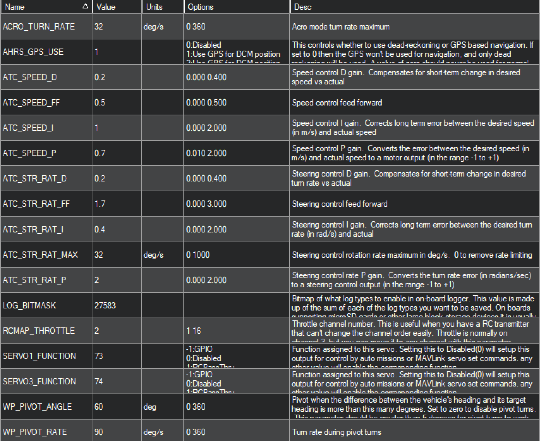
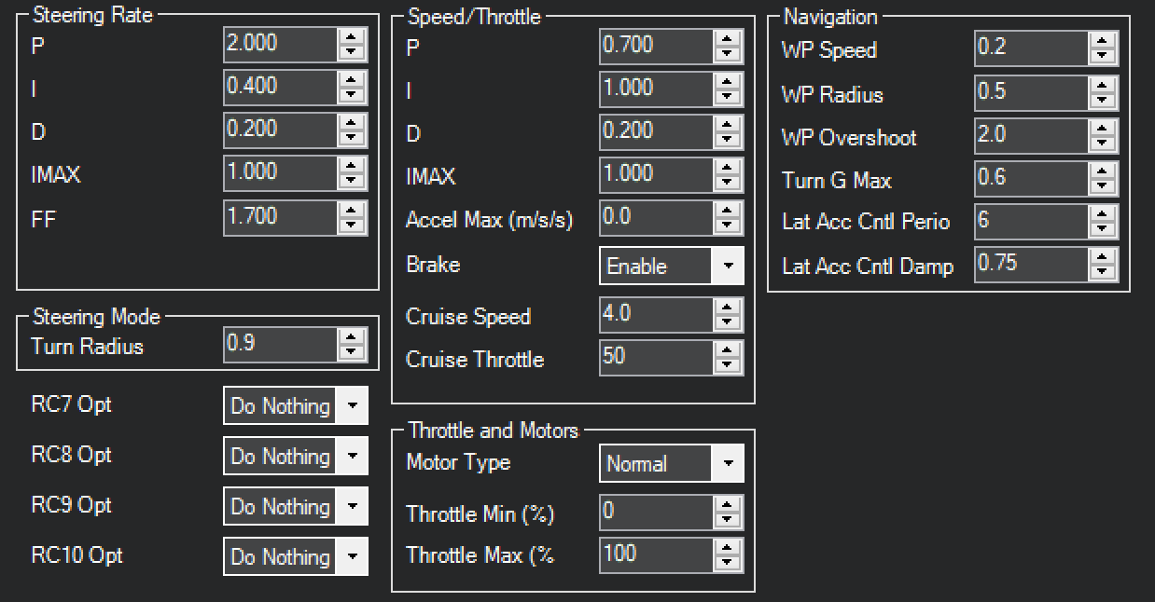
PID Tuning/Parameter List:

Slide 14
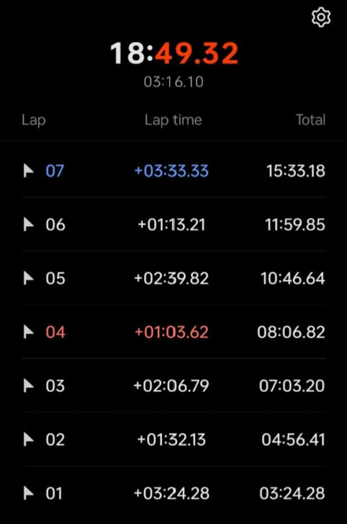
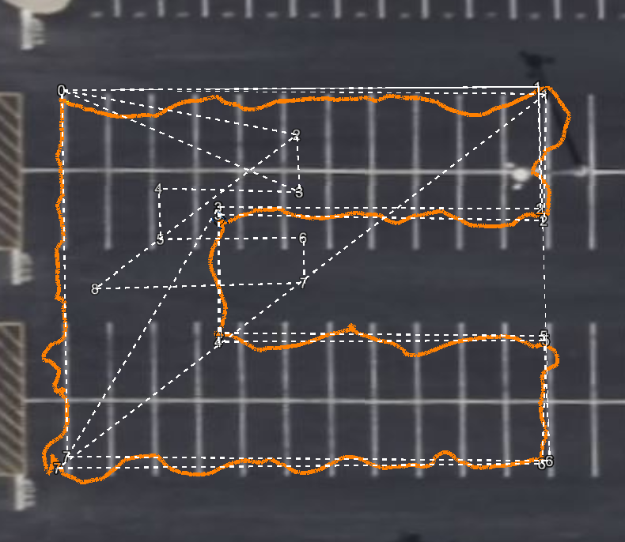
Path/Time to Complete:
Lap is each waypoint.
Lap time is how long each stretch from one waypoint to another took.

Slide 15
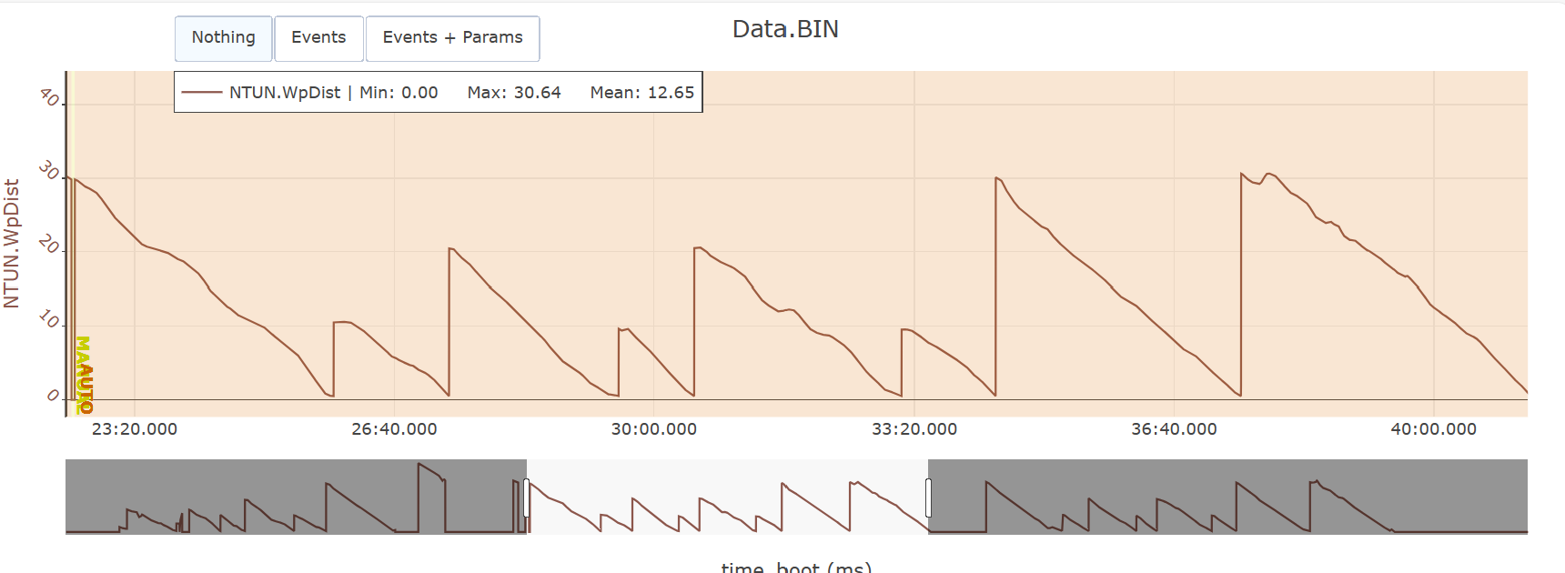
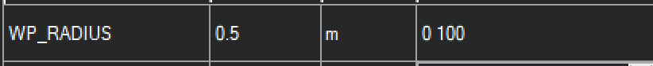
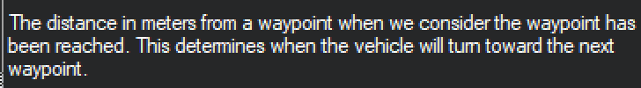

Autonomous Navigation Graphs:

Slide 16
Task II – Autonomous Navigation Data Collected:
16
Waypoints:
The waypoint radius was set to 0.5m, if the radius was set too big the waypoints would overlap causing the rover to go to the overlapped waypoint instead of the next. For example, the rover would go on a diagonal from the home waypoint to waypoint 3 instead of waypoint 1.
These were the waypoint distances used to map out the mission:
Home to 1 = 30
1 to 2 = 10
2 to 3 = 20
3 to 4 = 10
4 to 5 = 20
5 to 6 = 10
6 to 7 = 30
7 to Home = 30
The NTUN.WPDist maximum was 30.64m which was close to our longest distance mapped out
The NTUN.XTrack (or Error Distance) maximum was 1.47m and the mean was –0.04. The biggest errors happening from home to 1, 1 to 2, 6 to 7, and the start of 7 to home.
Home to 1 = the rover was inside the path the whole time instead of following the line.
1 to 2 = the rover gets to 1 then curves off the path only to get back on halfway to 2.
6 to 7 = the rover starts on the path then starts weaving on and off, first starting out small then getting bigger as it gets closer to 7.
7 to home = As the rover turns on 7 it immediately curves off the path, back on then weaves on and off the path for a bit until its straights itself out following the line to home.

Slide 17

17

